Slide 1
Progress Representation:
Recommendation System for Advertising Campaigns
Moderators: Prof. Kobi Gal, Yakir Ben-Aliz
Elinor Avraham | Nofet Damri | Lidor Rubi

Slide 2


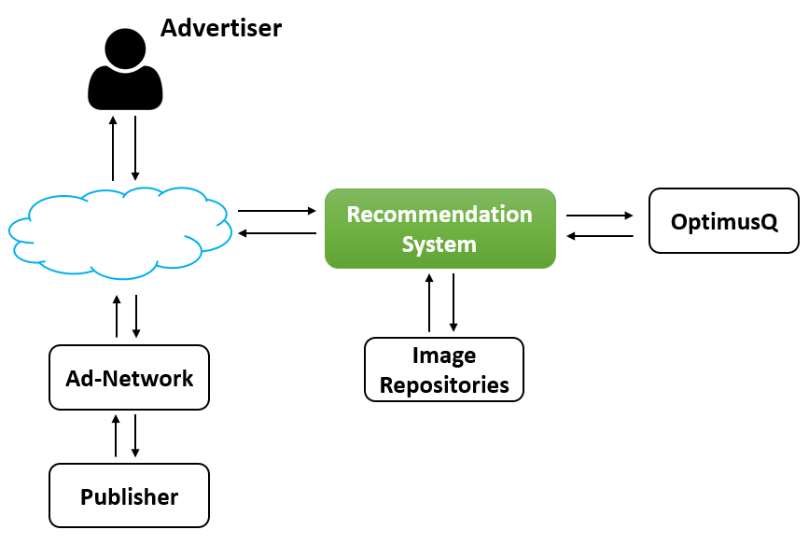
About Our System
RecoSystem allows you to analyze landing pages, extract the information it needs and classify the landing page in the appropriate category.
Next, the system will calculate by machine learning which image, among the image repositories, is most suitable for maximizing the landing page entries.

Slide 3

Examples For Advertisements
Not a good example for a photo

Slide 4
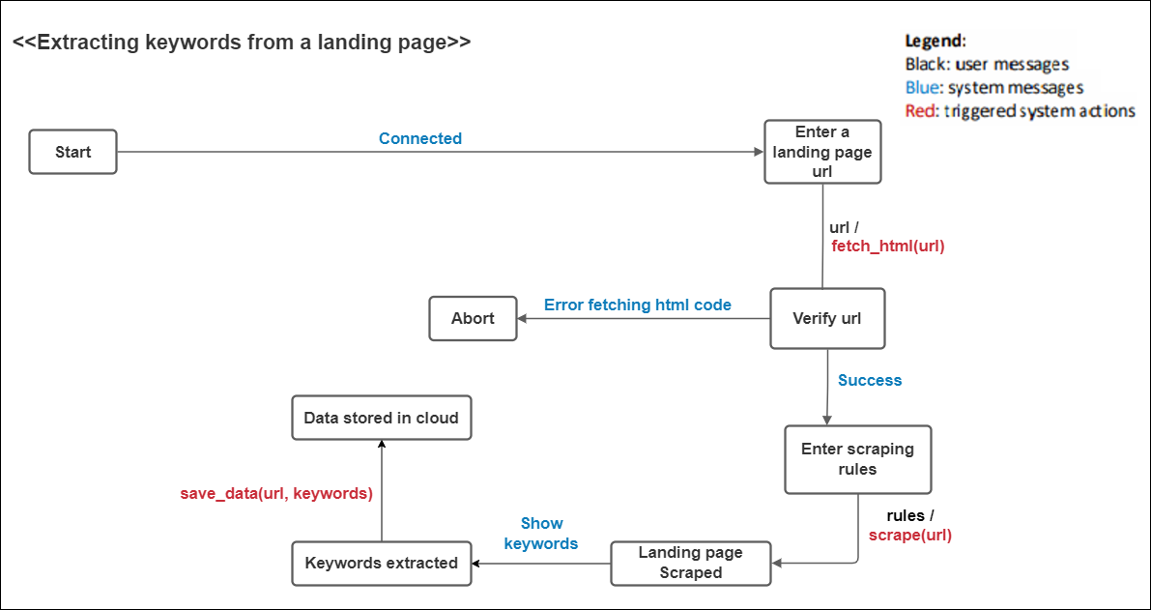
First Scenario: Extracting a Landing Page

Slide 5
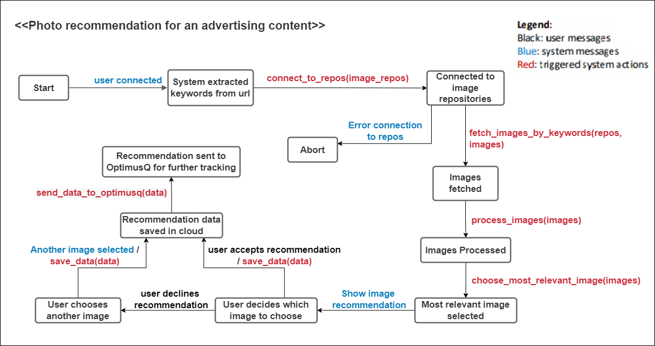
Second Scenario: Photo Recommendation

Slide 6
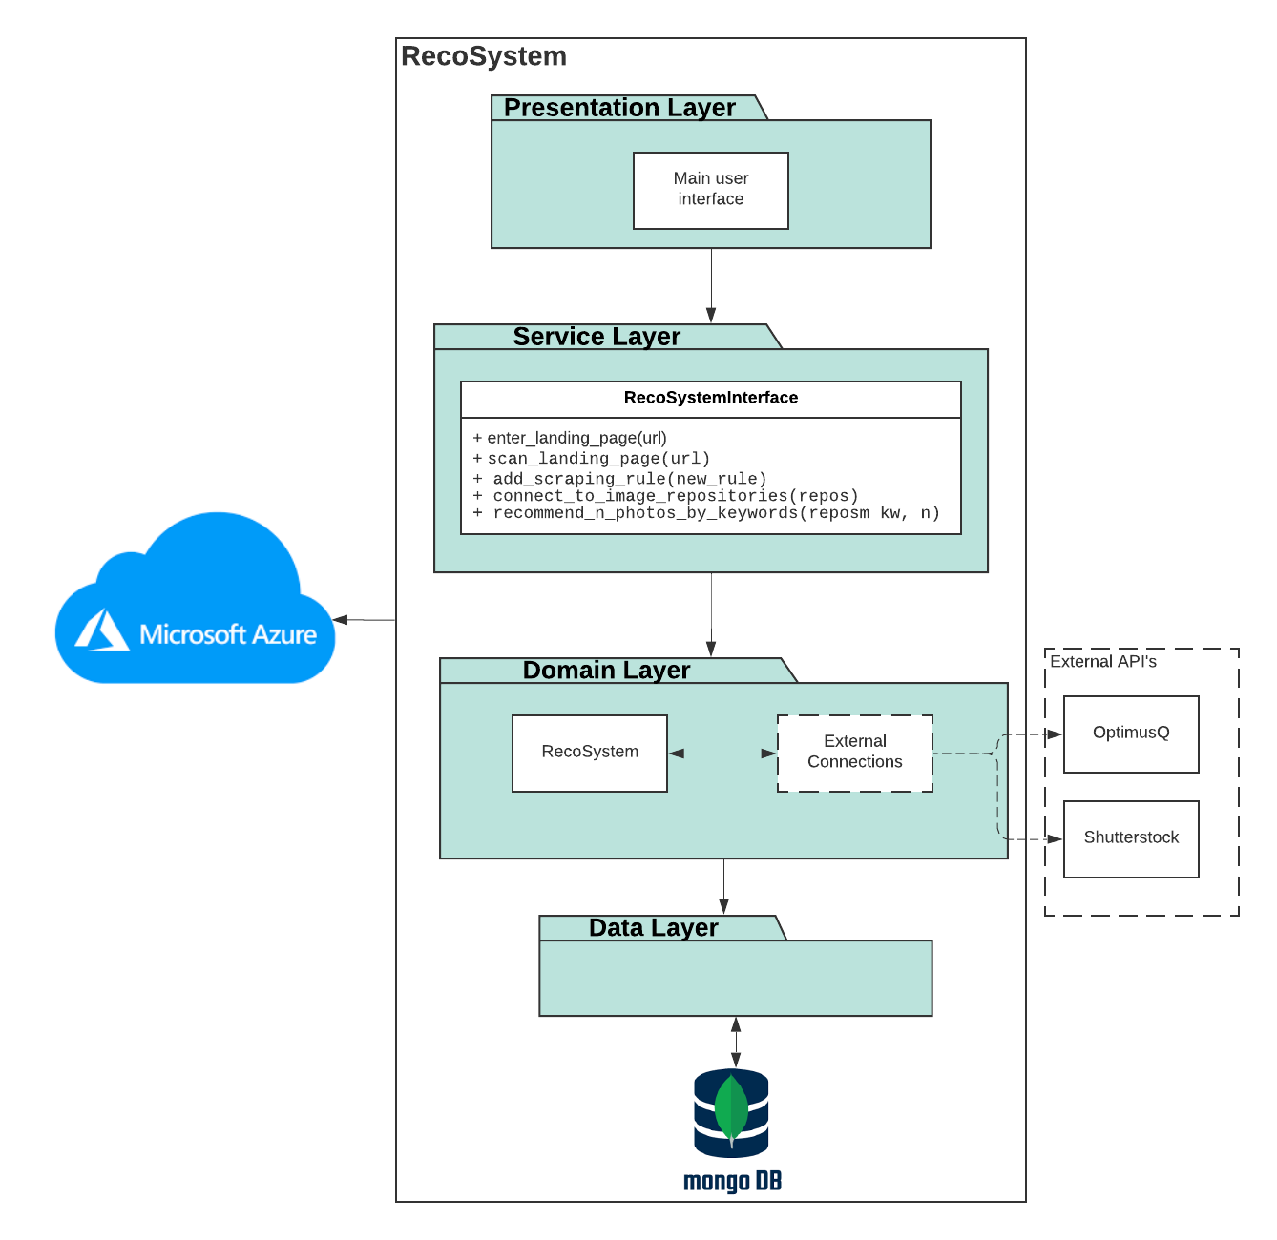
Initial Architecture

Slide 7
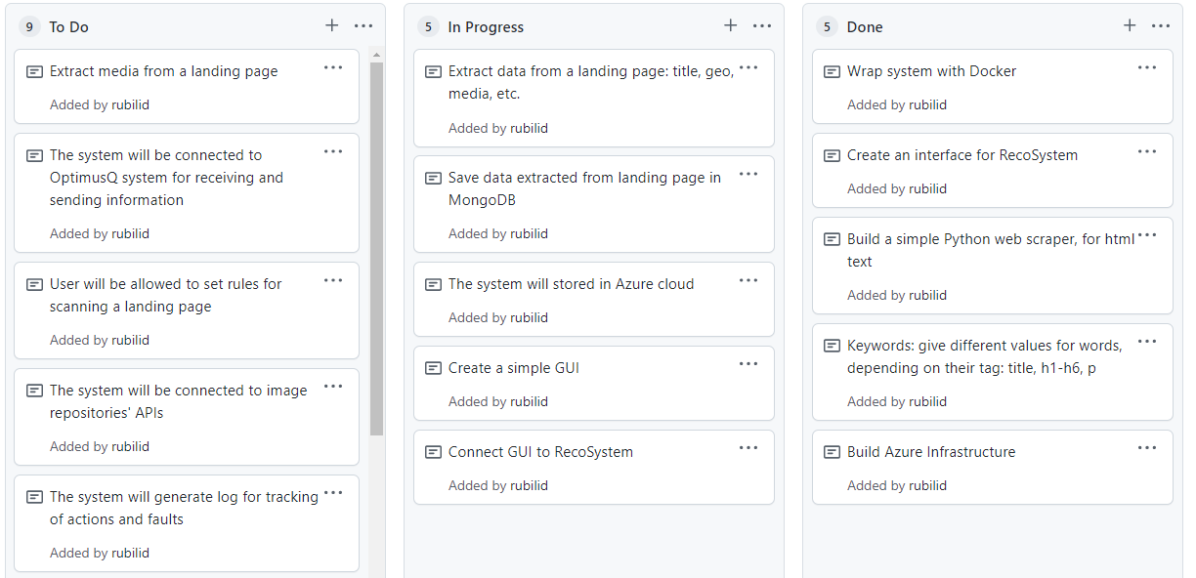
Progress
To Do
In Progress
Done

Slide 8
We will generate several landing pages using anstrex tool.
The system will contain a predefined configuration file, which will contain the landing pages for the POC.
The system should then scrape each landing page and extract relevant metadata.
The system will recommend images for each landing page.
Marathon Plan

